Slide 1
Writing article for NMI
https://www.nature.com/natmachintell/content

Slide 2
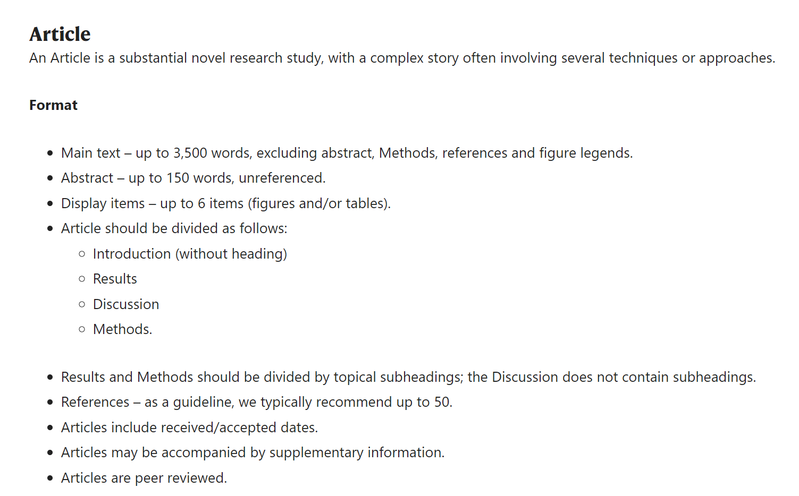
We have 10 figures and 5 tables, and that’s why other authors combining several tables and figures into a big figure. (example in next page.)
Main Section

Slide 3
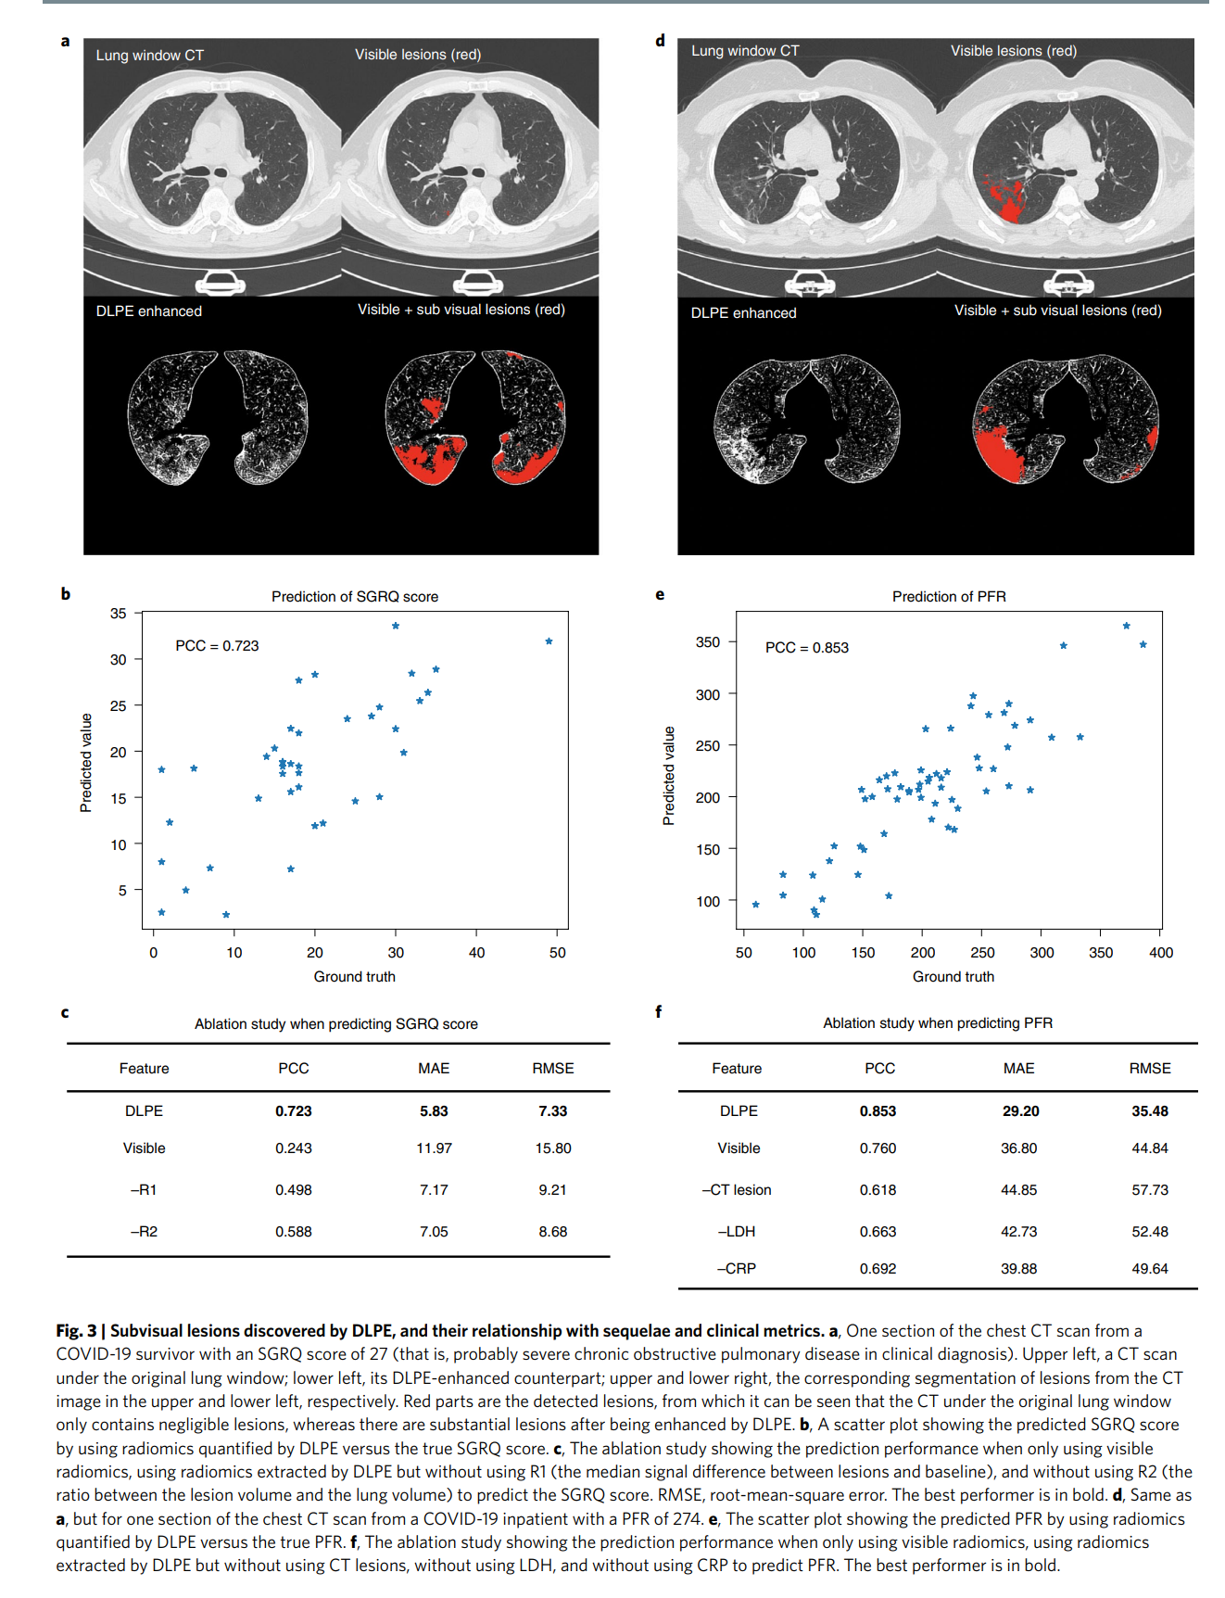
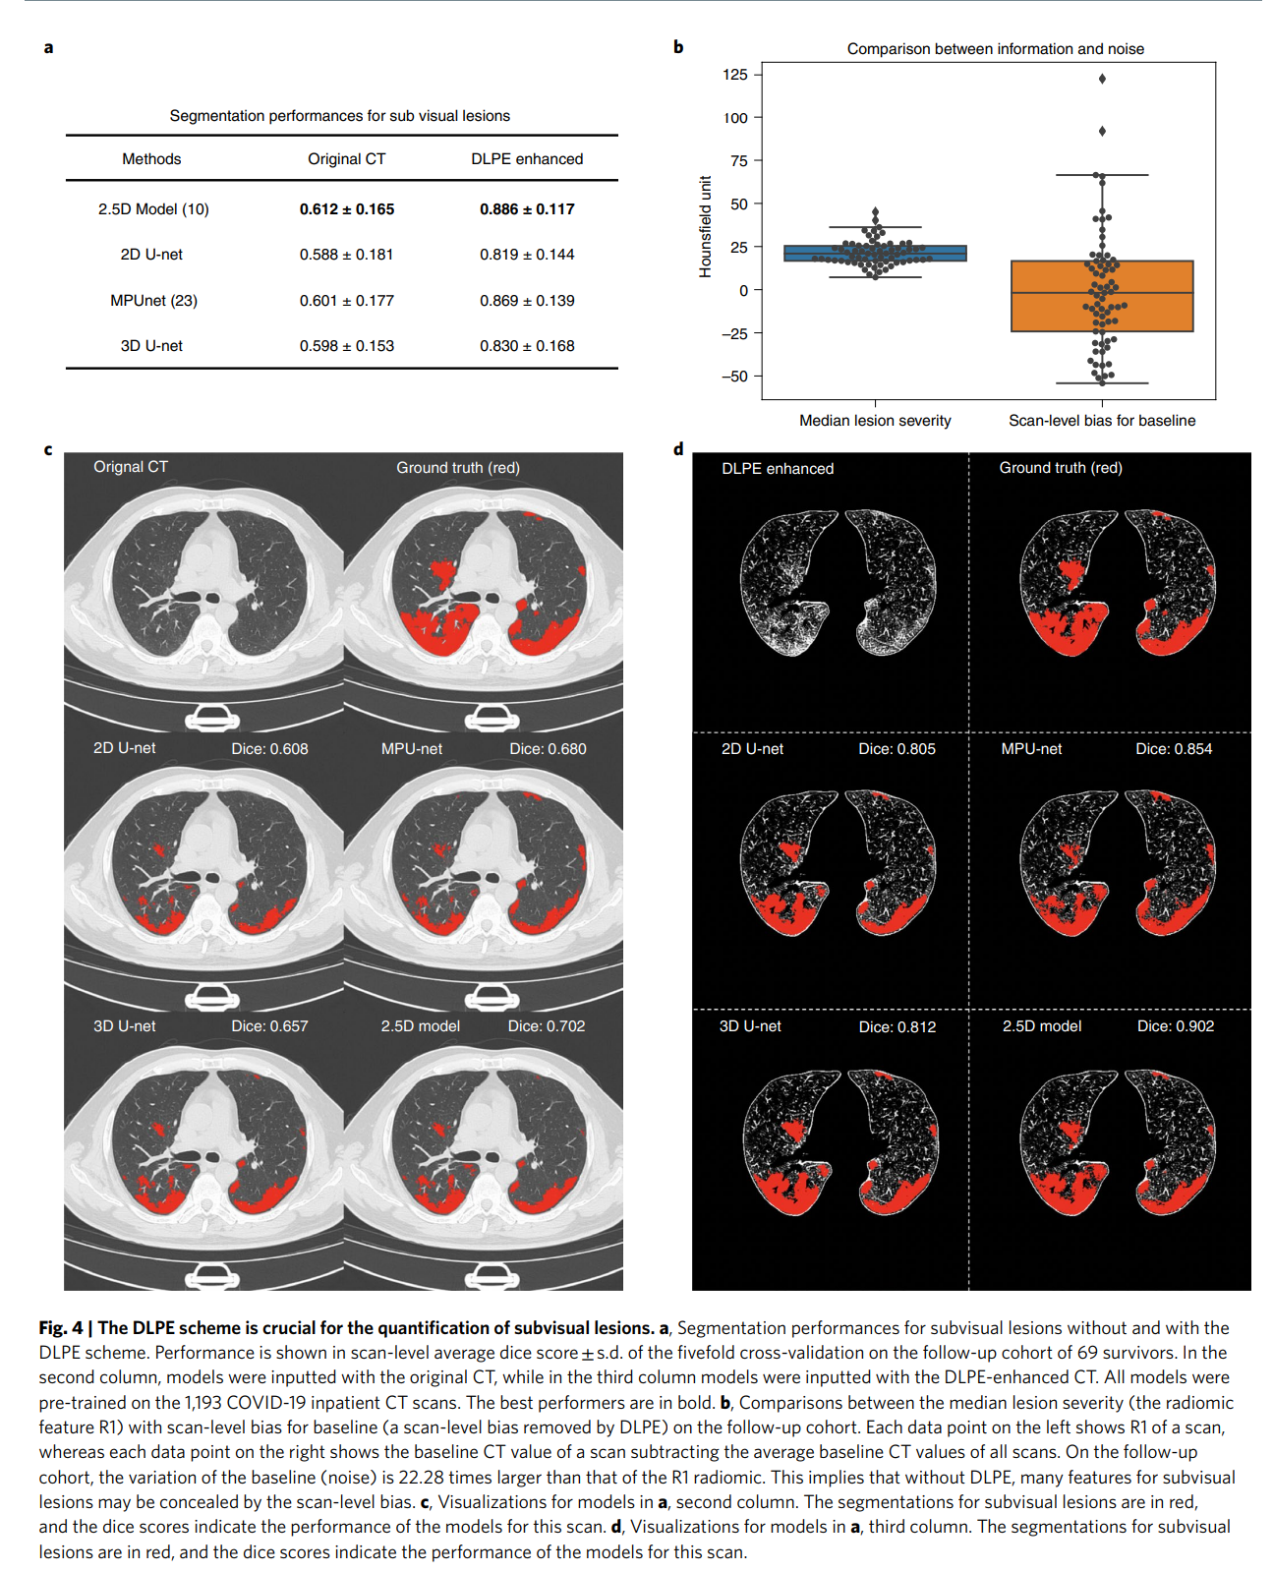

Slide 4

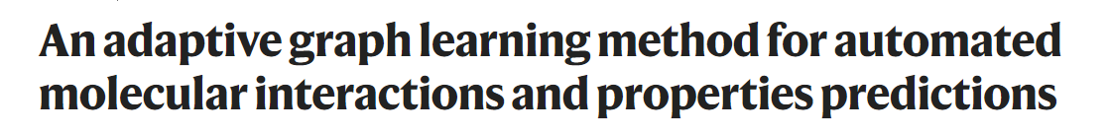
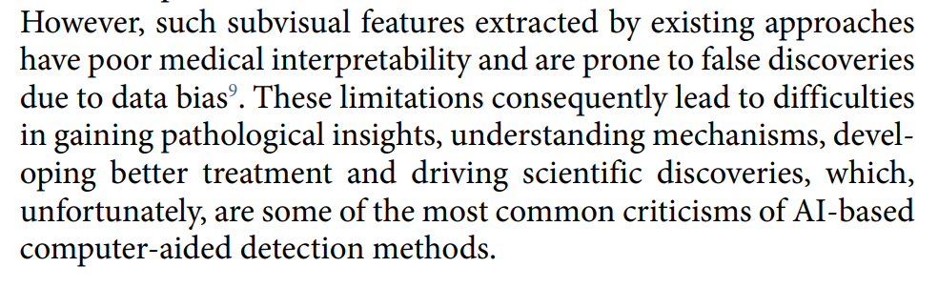
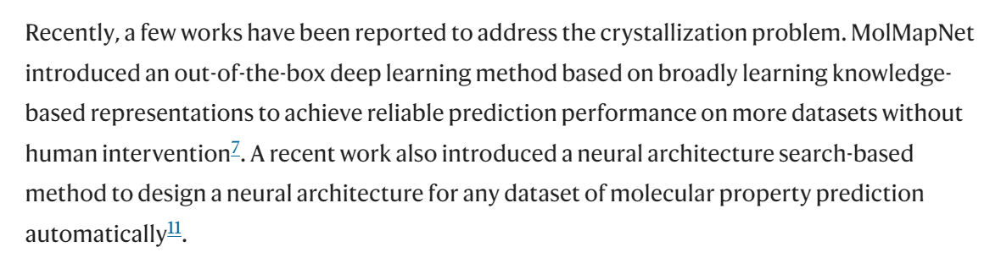

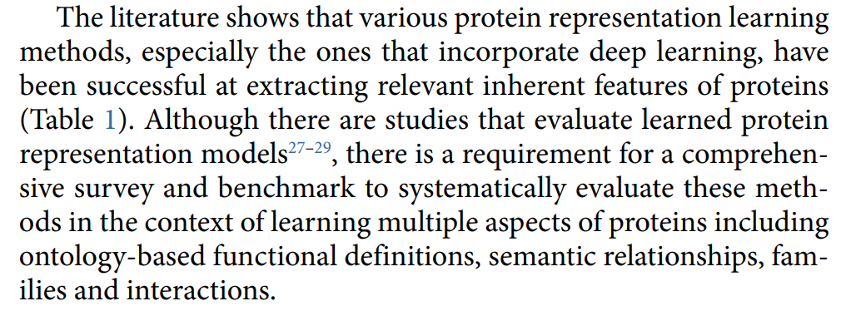
Only a brief background provided in the main section:
But I still need to move some important concepts in the background section to main section since we can’t explain those concepts in background section anymore.

Slide 5
